Slide 1
Business Forecasting —Walmart Sales Forecasting —
By Anirudh Gaur - 216007356 Manisha Damera - 220002345 Neha Thonta - 219009543 Rohit Macherla - 219008045 Vivek Reddy Chithari - 220002664

Slide 2
What is Business Forecasting?
Businesses are always looking for ways to increase profitability and one of the ways to do this is through Business Forecasting using Time Series.
Financial forecasts are fundamentally informed guesses, and there are risks involved in relying on past data and methods that cannot include certain variables for which EDA needs to be performed.
Forecasting approaches include qualitative models and quantitative models.
Past sales data is collected and analyzed so that patterns can be found to predict future sales.

Slide 3
Objective
Our Main Objective is to predict weekly sales of Walmart stores for two quarters after the given data. The input data consists of sales for two years, we analyze if sales are impacted by time-based factors and space-based factors. Most importantly how inclusion of holidays in a week soars the sales in store and finally forecast the sales using Time Series methods.

Slide 4
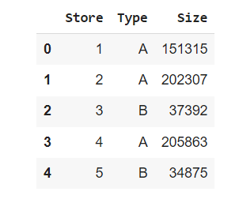
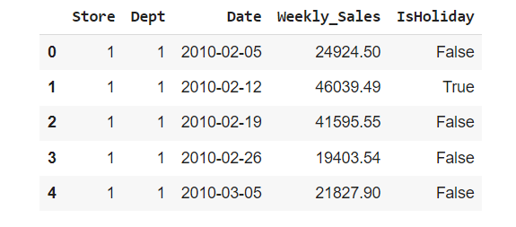
About Dataset
Walmart is a renowned retail corporation that operates a chain of hypermarkets. Here, Walmart has provided the data consists of 421570 rows combining 45 stores including store information and monthly sales. The data is provided on weekly basis. Walmart tries to find the impact of holidays on the sales of store. For which it has included four holidays’ weeks into the dataset which are Christmas, Thanksgiving, Super bowl, Labor Day.

Slide 5
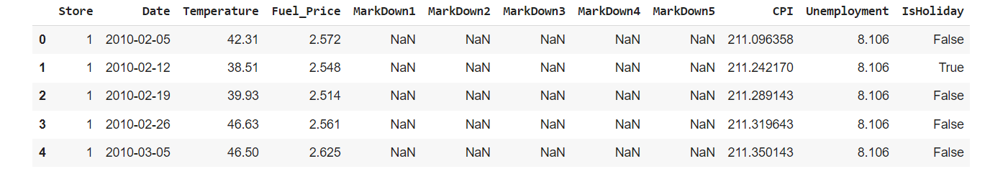
Features - contains data related to specific time frame respective temperature, fuel price, markdowns, CPI, unemployment, holidays data.

Slide 6
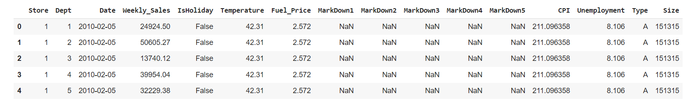
Merging all three DataFrames

Slide 7
Data Cleaning Process
We filtered rows which has positive weekly sales. So, we dropped about 0.3% of data.
Null values in markdowns ared changed to zero. Because, they were written as null if there were no markdown on this department.
New columns were created to analyze the effect of different holidays on the sales.

Slide 8
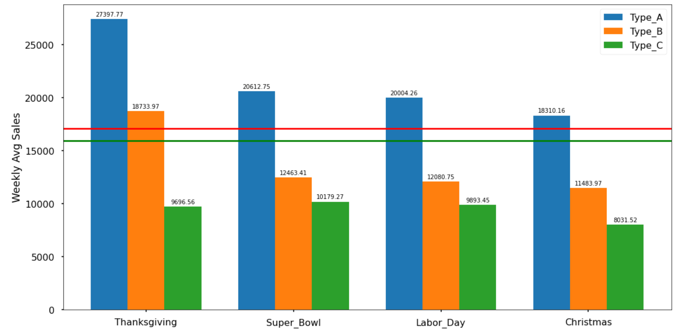
Holidays Effect on Sales

Slide 9
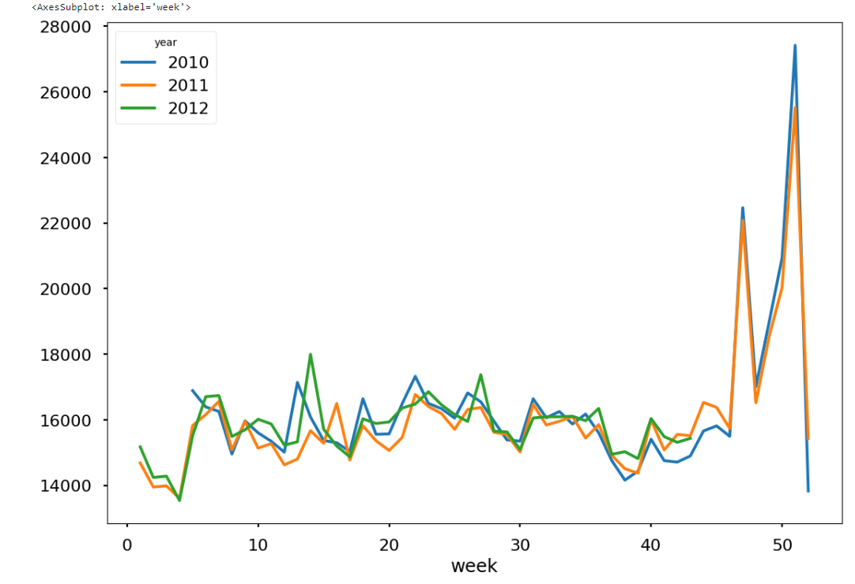
Average Weekly Sales over 3 years

Slide 10
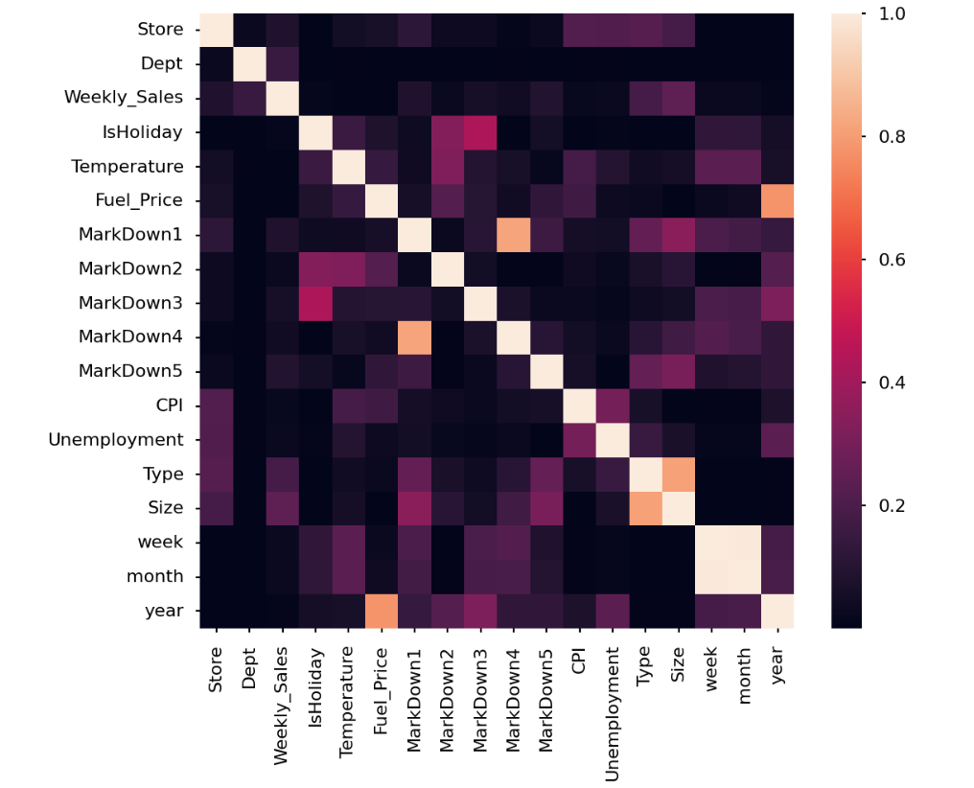
Correlation between features

Slide 11
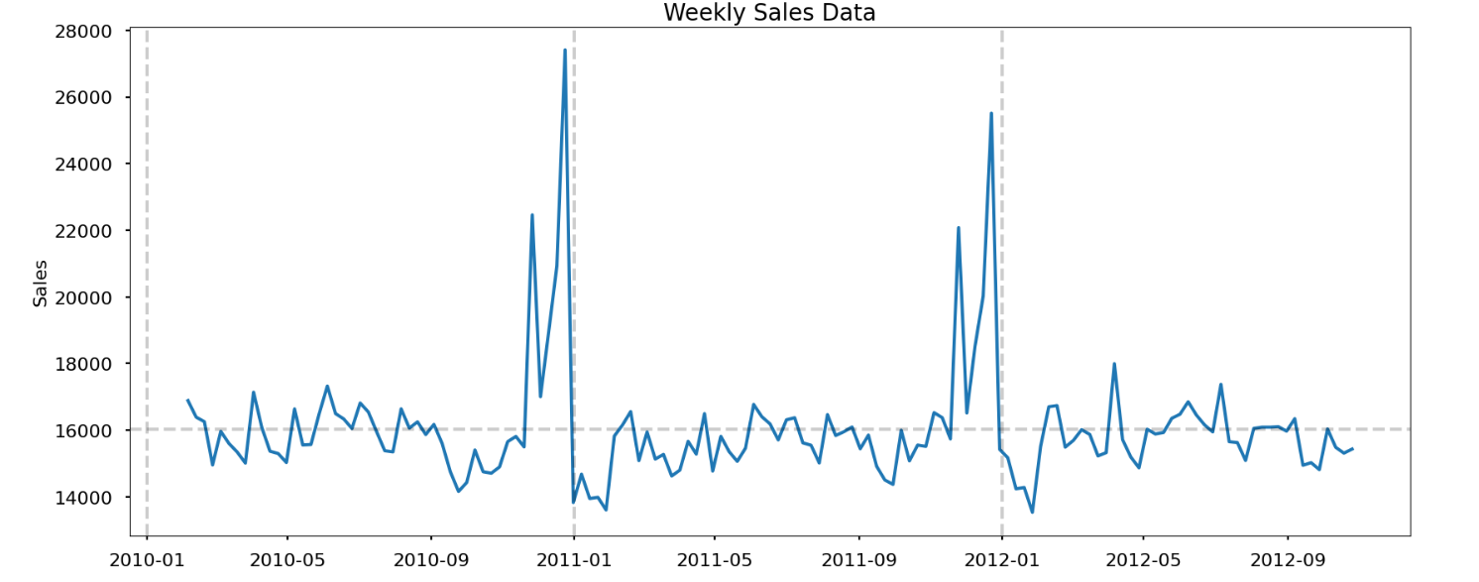
Time Series Analysis - Plotting Sales

Slide 12
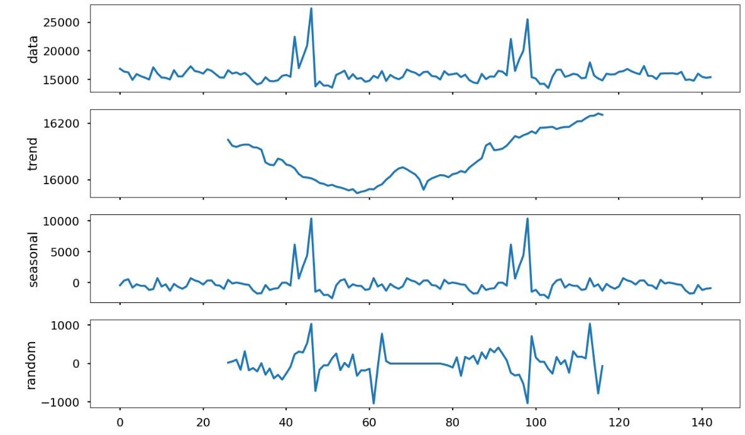
Decomposing Weekly Data to Observe Seasonality

Slide 13
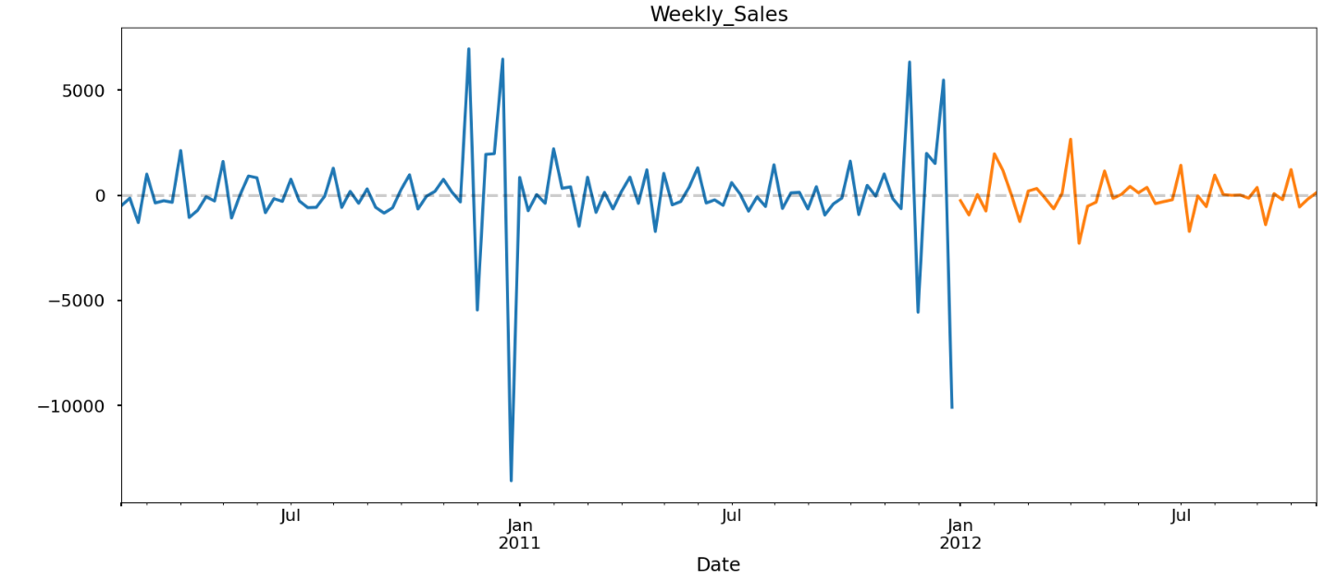
Creating Train & Test Splits
Since our data has continuity, we can’t split it randomly. Thus we split the data manually according to the 70%-30% training testing split which is the thumb rule.

Slide 14
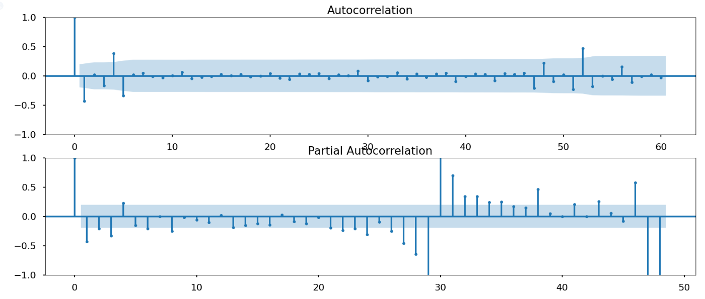
Plotting ACF & PACF

Slide 15
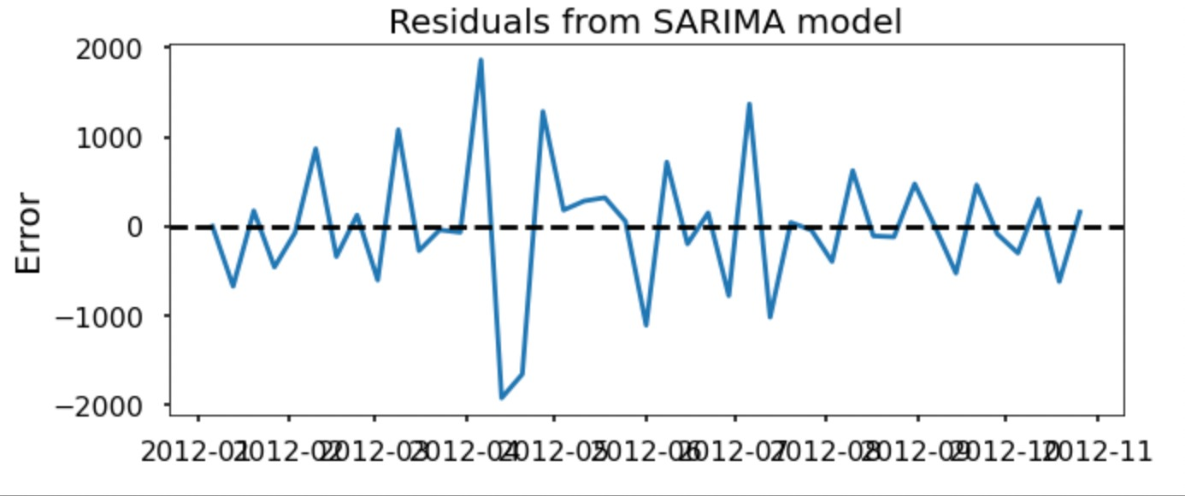
Plotting Residuals

Slide 16
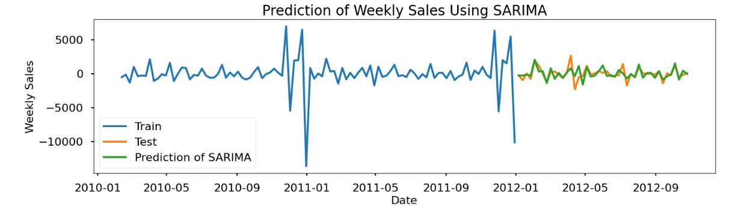
Predictions of Weekly sale by SARIMA

Slide 17
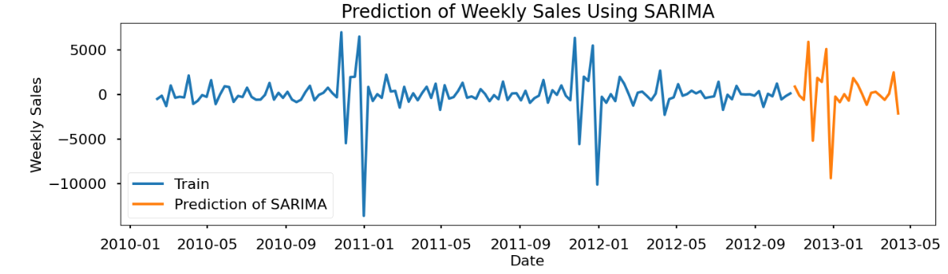
Future Predictions

Slide 18
References
Datasets:
https://www.kaggle.com/code/aslanahmedov/walmart-sales-forecasting/data?select=features.csv
https://www.kaggle.com/code/aslanahmedov/walmart-sales-forecasting/data?select=stores.csv
https://www.kaggle.com/code/aslanahmedov/walmart-sales-forecasting/data?select=Walmart_Store_sales.csv
Time Series Analysis:
https://thecleverprogrammer.com/2022/09/05/business-forecasting-using-python/
https://www.youtube.com/watch?v=ZoJ2OctrFLA&list=PLvcbYUQ5t0UHOLnBzl46_Q6QKtFgfMGc3&ab_channel=ritvikmath

Slide 19
THANK YOU!!!

